Slide 1
Measuring Effectiveness of Mutant Sets
Rahul Gopinath Amin Alipour Iftekhar Ahmed Carlos Jensen Alex Groce
Notes:
Hello, I am Rahul Gopinath, PhD Candidate at Oregon State University. I am here to talk about measuring effectiveness of mutant sets.

Slide 2
Mutation analysis is the best technique for test suite quality measurement. Involves injection of first order faults, which are then evaluated to determine the mutation score. A number of mutation tools exist, and they have different strategies to produce mutants (byte code mutation, source code mutation, different operator sets etc.) How to compare the effectiveness of the mutants generated by these tools?
Mutation analysis
Notes:
Mutation analysis remains the best and most direct technique for evaluating effectiveness of test suites.
It involves exhaustive injection and analysis of first order faults.
A number of tools exist for mutation analysis, with different strategies and operator sets for creating mutants often for the same language.
The comparison of the mutants generated by these tools is still an open problem.

Slide 3
Mutation analysis is an expensive technique for test suite quality measurement. A majority of mutants encode similar faults. Some of them are also easy to detect. Avoiding duplicate or trivial mutants can help lower the expenditure.
Mutation analysis
Notes:
Mutation analysis involves exhaustive injection and analysis of first order faults. However, the number of such faults are huge, which makes mutation analysis expensive.
The cost of mutation analysis may be lowered by reducing the number of mutants that we generate and analyze.
For example, not all faults produce unique runtime behaviors.
Further, some of the faults are trivial to detect, and may not contribute much to the effectiveness of mutation analysis.

Slide 4
Avoiding redundant or trivial mutants
Mutation reduction strategies
Selective mutation using operator selection
Static analysis of generated mutants
Dynamic analysis using coverage based techniques
Mutation clustering to identify similar mutants
But how do we compare the effectiveness of these techniques?
Notes:
A number of strategies are used to reduce the number of mutants to be evaluated.
These include selective mutation using operator selection, static and dynamic analysis of generated mutants using invariants or coverage metrics, and mutation clustering.
But how do we compare the effectiveness of these techniques?

Slide 5
Judging mutant sets
How do we compare the effectiveness of mutant sets?
Mutation analysis is used to evaluate test suite quality. To compare mutant sets, we can evaluate how good they are in evaluating test suites.
Notes:
The common theme is a need to evaluate the effectiveness of mutant sets.
In order to compute the effectiveness, we look at where mutant sets are used in practice.
Mutation analysis is used to judge adequacy of test suites. Hence the set of mutants should be judged on how best it helps to judge adequacy of test suites.

Slide 6
Judging test suites.
A test suite is measured (usually) on two criteria
Does it prevent a majority of bugs?
Does it prevent subtle bugs?
Notes:
For a test suite, there are mainly two things that a tester is interested in
The first one is, is it comprehensive enough? That is, does it prevent a majority of bugs?
The second and harder one is, does it prevent subtle bugs?

Slide 7
Measures for mutant sets
A variation measure:
How much variation does the set of mutants encode?
A measure of thoroughness:
How many hard to find faults does the set of mutants represent?
For these measures, what we are looking for is a set of mutants that capture the essential characteristics of the original set, which may be compared against the original set.
Notes:
Bringing these requirements for mutation analysis, a mutant set should be judged based on how best it allows these measurements.
Thus there are two general requirements for any mutant set, which need not be satisfied by the same strategy.
The first is that the mutants need to be sufficiently diverse. That is they should encode as many different bugs as possible without regard to whether a bug is hard to detect or not.
The second is that the mutants need to be sufficiently hard to detect.
In summary, a reduced set should provide us with
1) A set of non-redundant faults, and
2) A (smaller) set of hard to find faults

Slide 8
Important definitions
Fault : An erroneous part of a program. A mutation is a fault introduced intentionally.
Mutant: A program with a mutation (fault) in it.
Variant: A mutant that shows a deviation in runtime from the original program. Multiple mutants can result in the same variant.
Notes:
We have a few important definitions before we proceed further
A Fault is an erroneous part of a program and a Mutation is a fault introduced intentionally.
A Mutant is a program with a fault in it, and a Variant is a mutant that shows a deviation in runtime from the original program.
Multiple mutants can map to the same variant, and a unique variant shows a unique deviation with respect to a set of mutants and corresponding variants.

Slide 9
Measuring effectiveness of mutant sets
Current research:
Size of Minimum set of mutants[Ammann2014]
(also called Disjoint mutants[kintis2010])
Notes:
Current research by Ammmann and others suggest using the size of minimal mutants or disjoint mutants as a measure of effectiveness of a set of mutants.

Slide 10
Disjoint mutant sets
A minimum test suite for a mutant set is the smallest test suite that can kill all mutants in the set.
A minimal (disjoint) mutant set corresponding to a minimum test suite is the smallest set of mutants that require all test cases in the test suite to kill.
Assumptions:
A test case provides no extra value if it is unable to kill more mutants than the test suite without it.
Given a minimal test suite, a mutant that is killed by a strict superset of test cases of another is redundant.
The size of minimum disjoint mutant set is usually taken as the effectiveness measure of a set of mutants. Computing the minimum set is NP-Complete. So we make do with computing an approximation.
Notes:
Essentially a minimum test suite is the smallest test suite that can kill all mutants in a given set of mutants.
A minimal disjoint mutant set is the smallest set of mutants that require all of a minimal test suite to kill.
The disjoint mutant set has two assumptions.
The first is that a test case provides no extra value if it is unable to kill more mutants than the test suite without it.
The second, given a minimal test suite, a mutant that is killed by a strict superset of test cases of another is redundant.
Computing the minimum set of mutants is however NP-Complete.

Slide 11
Subsumption of mutants
A mutant m1 is said to subsume m2 if m1 is detected by a subset of test cases compared to m2
Notes:
Before we go further, we need to understand subsumption of mutants.
A mutant m1 is said to subsume m2 if m1 is detected by a subset of test cases that detects m2

Slide 12
Subsumption of mutants
A mutant M1is said to subsume M2 if M1 is detected by a subset of test cases compared to M2
E.g.
m1 killed by t1, t2
m2 killed by t1, t2, t3
Detecting test cases
m2
t3
m1
t1
t2
Notes:
In this example, m1 is killed by t1 and t2 while m2 is killed by t1 t2 and t3.
That is, m1 is killed by a subset of test cases that kills m2

Slide 13
Subsumption of mutants
A mutant M1is said to subsume M2 if M1 is detected by a subset of test cases compared to M2
E.g.
m1 killed by t1, t2, t3
m2 killed by t1, t2
m3 killed by t1, t4
m2 is subsumed by m1 but not by m3
Detecting test cases
m2
t3
m1
m3
t2
t1
t4
Notes:
The mutant m3 is killed by t1 and t4. That is, it has an overlap with both m1 and m2 but is not a subset of either.
In this example, m2 is subsumed by m1, but not by m3

Slide 14
Computing the disjoint mutant set
Input:
Tests | Mutants killed by the given test
t1 | m1 | m2 |  | m4
t2 | m1 |  | m3 | m4
t3 |  | m2 | m3 | m4
Notes:
So here is how we actually compute the disjoint mutant set.
We start with the matrix of tests and their mutant kills.

Slide 15
Computing the disjoint mutant set
Input:
Tests | Mutants killed by the given test
t1 | m1 | m2 |  | m4
t2 | m1 |  | m3 | m4
t3 |  | m2 | m3 | m4
Pick one test case = {t1}
Notes:
Pick a single test case as our test suite. Let us say t1

Slide 16
Computing the disjoint mutant set
Input:
Tests | Mutants killed by the given test
t1 | m1 | m2 |  | m4
t2 | m1 |  | m3 | m4
t3 |  | m2 | m3 | m4
Pick test suite = t1
It kills m1
Notes:
We know that t1 kills the mutant m1

Slide 17
Computing the disjoint mutant set
Input:
Tests | Mutants killed by the given test
t1 | m1 | m2 |  | m4
t2 |  |  | m3 | m4
t3 |  | m2 | m3 | m4
Pick test suite = t1
It kills m1
Notes:
So remove m1 from the list of mutants considered.

Slide 18
Computing the disjoint mutant set
Input:
Tests | Mutants killed by the given test
t1 | m1 | m2 |  | m4
t2 |  |  | m3 | m4
t3 |  | m2 | m3 | m4
Pick test suite = t1
It kills m1,m2
Notes:
It also kills m2

Slide 19
Computing the disjoint mutant set
Input:
Tests | Mutants killed by the given test
t1 | m1 | m2 |  | m4
t2 |  |  | m3 | m4
t3 |  |  | m3 | m4
Pick test suite = t1
It kills m1,m2
Notes:
so remove m2.

Slide 20
Computing the disjoint mutant set
Input:
Tests | Mutants killed by the given test
t1 | m1 | m2 |  | m4
t2 |  |  | m3 | m4
t3 |  |  | m3 | m4
Pick test suite = t1
It kills m1,m2,m4
Notes:
It kills m4

Slide 21
Computing the disjoint mutant set
Input:
Tests | Mutants killed by the given test
t1 | m1 | m2 |  | m4
t2 |  |  | m3
t3 |  |  | m3
Pick test suite = t1
It kills m1,m2,m4
Notes:
hence we remove m4.

Slide 22
Computing the disjoint mutant set
Input:
Tests | Mutants killed by the given test
t1 | m1 | m2 |  | m4
t2 |  |  | m3
t3 |  |  | m3
Pick test suite = t1
It kills m1,m2,m4
Add t2 to the test suite = t1,t2
Notes:
Since all mutants killed by t1 are finished, but there are mutants pending, pick the next test case t2

Slide 23
Computing the disjoint mutant set
Input:
Tests | Mutants killed by the given test
t1 | m1 | m2 |  | m4
t2 |  |  | m3
t3 |  |  | m3
Pick test suite = t1
It kills m1,m2,m4
Add t2 to the test suite = t1,t2
It kills m3
Notes:
It kills m3

Slide 24
Computing the disjoint mutant set
Input:
Tests | Mutants killed by the given test
t1 | m1 | m2 |  | m4
t2 |  |  | m3
t3
Pick test suite = t1
It kills m1,m2,m4
Add t2 to the test suite = t1,t2
It kills m3
Notes:
so we take m3 out.

Slide 25
Computing the disjoint mutant set
Input:
Tests | Mutants killed by the given test
t1 | m1 | m2 |  | m4
t2 |  |  | m3
t3
Pick test suite = t1
It kills m1,m2,m4
Add t2 to the test suite = t1,t2
It kills m3
All mutants are accounted for.
The remaining: t3 is not included in the minimal test suite.
Notes:
Now all mutants are accounted for. The final test case t3 is not needed to kill any mutants. Hence we discard t3.

Slide 26
Computing disjoint mutant set
Input:
Tests | Mutants killed by the given test
t1 | m1 | m2 |  | m4
t2 | m1 |  | m3 | m4
t3 |  | m2 | m3 | m4
Compute minimum test suite: {t1,t2}
Notes:
So this is the minimal test suite and the mutants killed by each test case.

Slide 27
Computing disjoint mutant set
Input:
Tests | Mutants killed by the given test
t1 | m1 | m2 |  | m4
t2 | m1 |  | m3 | m4
t3 |  | m2 | m3 | m4
Compute minimum test suite: {t1,t2}
Remove subsumed mutants:
M | Tests killing given Mutant
m1 | t1 | t2
m2 | t1
m3 |  | t2
m4 | t1 | t2
Notes:
Next, we try to remove the subsumed mutants. We represent the same matrix as tests killing mutants.
Here, m1 is subsumed by m2 hence we remove m1

Slide 28
Computing disjoint mutant set
Input:
Tests | Mutants killed by the given test
t1 | m1 | m2 |  | m4
t2 | m1 |  | m3 | m4
t3 |  | m2 | m3 | m4
Compute minimum test suite: {t1,t2}
Remove subsumed mutants:
M | Tests killing given Mutant
m1 | t1 | t2
m2 | t1
m3 |  | t2
m4 | t1 | t2
Notes:
Next, we also see that m4 is subsumed by m2

Slide 29
Computing disjoint mutant set
Input:
Tests | Mutants killed by the given test
t1 | m1 | m2 |  | m4
t2 | m1 |  | m3 | m4
t3 |  | m2 | m3 | m4
Compute minimum test suite: {t1,t2}
Remove subsumed mutants:
M | Tests killing given Mutant
m1 | t1 | t2
m2 | t1
m3 |  | t2
m4 | t1 | t2
Notes:
So we remove m4.
There are no more subsumed mutants.

Slide 30
Computing disjoint mutant set
Input:
Tests | Mutants killed by the given test
t1 | m1 | m2 |  | m4
t2 | m1 |  | m3 | m4
t3 |  | m2 | m3 | m4
Compute minimum test suite: {t1,t2}
Remove subsumed mutants:
M | Tests killing given Mutant
m1 | t1 | t2
m2 | t1
m3 |  | t2
m4 | t1 | t2
M | Tests killing given Mutant
m2 | t1
m3 |  | t2
Disjoint mutant set = {m2,m3}
Notes:
So we have the minimum disjoint mutant set given by {m2,m3}

Slide 31
Disjoint mutant set as the set of unique variants
Does the disjoint set of mutants represent all unique variants?
Or, can it be used as a measure of redundancy in the mutant set?
Can represent only as many variants as there are test cases in the minimal test suite (the minimal test suite is usually much smaller than the full test suite.).
Hence, only if we assume that each test case in minimal test suite kills separate unique variants.
This is rarely the case.
Notes:
How effective is the disjoint mutant set as a variation measure?
An effective variation measure should identify all unique variants in a set of mutants.
However, the set of disjoint mutants is not representative of all unique variants, especially given that it is limited by the size of test suite.
That is, we require a test suite that is as large as the number of unique variants expected for the disjoint mutant set to be able to represent all variants.

Slide 32
Disjoint mutants as a measure of thoroughness
Tests | Mutants killed by the given test
t1 | m1 | m1
t2 | m1 |  | m3
t3 |  | m2 | m3
We need only t1,t2 or t2,t3, or t1,t3 to kill all three mutants. Even though all three are plainly of similar strength.
The minimum mutant set is only m1,m2, or m2,m3, or m1,m3
Disjoint mutants sets may throw away mutants that are not subsumed by any others individually.
Notes:
How effective is disjoint mutants as a measure of thoroughness?
In this table, we need only two tests to kill mutants m1, m2, and m3.
That is, any pair of mutants represent the minimum mutant set discarding the final mutant. However it can be seen that all three mutants are different, and of similar strength.
Which means that the set of disjoint mutants do not represent the full set of hardest to find faults. Some mutants may be spuriously discarded.

Slide 33
A summary of disjoint mutant set
Disjoint mutant set provides neither the best set of unique faults, nor the complete set of hardest to find faults from the given mutant set.
Notes:
In summary, disjoint mutant set provides neither the best set of unique faults, nor he complete set of hardest to find faults from the given set of mutants.

Slide 34
Measure of variation : Distinguished or unique mutants
Essentially, if there is evidence that two mutants are similar (in terms of test kills), remove duplicates.
The total number of such distinguished or unique mutants is taken as a variation measure.
Much better sensitivity (2^T) than disjoint mutants (T) where T is the size of the test suite.
Assumptions
Two mutants represent different variants if the tests killing them are different.
Two mutants are similar if the tests killing them are exactly the same.
Notes:
Here is a different idea.
When we consider all the unique variants, is the subsumption of mutants useful?
If we are interested in the complete the unique variants, why not just consider the pattern of test kills?
We can account for a much larger number of unique mutants than what is possible with distinguished mutants.
The unique mutants have just two assumptions. The first is that two mutants represent different variants if the tests killing them are different
Second, two mutants are similar if the tests killing them are exactly the same.

Slide 35
A summary of distinguished mutants
A larger set of mutants than those included in disjoint mutant set.
Simpler assumptions than disjoint mutants.
Easier to compute than size of disjoint mutant set.
Notes:
That is, distinguished mutants result in a larger set of mutants than those included in disjoint mutant set.
Consequently, this provides a finer measure than disjoint mutant set.
It also relies on a simpler set of assumptions; essentially that if there is evidence that two mutants are similar, then remove the duplicates.
It is also the easier to compute than disjoint mutant sets.

Slide 36
Measure of thoroughness : Surface mutants
Produced by applying mutant subsumption with complete test suite (rather than minimal test suite).
Underlying model:
Imagine an n-dimensional space; each test case a dimension.
Variant not killed by t1 but by t2
v1
t1
Variant killed by both t1 and t2
v0
v2
Variant not killed by t2 but by t1
t2
Notes:
The other measure we use to evaluate a mutant set is how difficult the selected mutants are to detect.
The surface mutants considers the variants arranged in an n-dimensional space. Each test is a dimension and the variant at its center is killed by all test cases.
In the picture here, the variant v0 is killed by tests t1 and t2. The variant v1 is killed only by t2, and the variant v2 is killed only by t1.

Slide 37
Surface mutants
Variant not killed by t1 but by t2
v1
t1
Variant killed by both t1 and t2
v0
v2
Variant not killed by t2 but by t1
t2
v0 is easier to kill than v1 or v2
If we can both v1 and v2, we can guarantee that v0 will be killed.
Notes:
Notice that, if we can kill v1 and v2, v0 will be guaranteed to be killed.

Slide 38
Surface mutants
Variant killed by only t2
Variant not killed by t1 but by t2,t3
v1
t1
Variant killed by t1 t2 and t3
v4
v0
v2
Variant not killed by t2 but by t1,t3
t2
t3
v3
Variant killed by only t1
Notes:
This graph shows Extending it to 3 dimensions, by adding test t3 and two variants v3 and v4.
Here, any test suite that can kill v4 is guaranteed to kill v1, and v0. Similarly any test suit that can kill v3 can also kill v2.

Slide 39
Surface mutants
Variant killed by only t2
Variant not killed by t1 but by t2,t3
v1
t1
Variant killed by t1 t2 and t3
v4
v0
v2
Variant not killed by t2 but by t1,t3
t2
t3
v3
Variant killed by only t1
Notes:
That is the two variants v3 and v4 together can represent the entire set of mutants v0 through v4.
Since these represent a kind of surface, we call these mutants the surface mutants. Any mutant included in the volume is guaranteed to be detected if the surface mutants are detected.

Slide 40
Computing surface mutant set
Tests | Mutants killed by the given test
t1 | m1 | m2 |  | m4
t2 | m1 |  | m3 | m4
t3 |  | m2 | m3 | m4
M | Tests killing given Mutant
m1 | t1 | t2
m2 | t1 |  | t3
m3 |  | t2 | t3
m4 | t1 | t2 | t3
Notes:
This is how we compute the surface mutants.
Here is the same matrix we considered earlier, with tests, and the mutants they kill. The two matrix are just different representations of the same information.

Slide 41
Computing surface mutant set
Tests | Mutants killed by the given test
t1 | m1 | m2 |  | m4
t2 | m1 |  | m3 | m4
t3 |  | m2 | m3 | m4
M | Tests killing given Mutant
m1 | t1 | t2
m2 | t1 |  | t3
m3 |  | t2 | t3
m4 | t1 | t2 | t3
Remove subsumed mutants
Notes:
First consider the mutants m1 and m4. m1 is killed by a subset of test cases than m4. Hence we mark m1 as subsumed.

Slide 42
Computing surface mutant set
Tests | Mutants killed by the given test
t1 | m1 | m2 |  | m4
t2 | m1 |  | m3
t3 |  | m2 | m3
M | Tests killing given Mutant
m1 | t1 | t2
m2 | t1 |  | t3
m3 |  | t2 | t3
m4 | t1 | t2 | t3
Remove subsumed mutants
M | Tests killing given Mutant
m1 | t1 | t2
m2 | t1 |  | t3
m3 |  | t2 | t3
Surface mutant set = {m1,m2,m3}
Notes:
None of the other mutants are subsumed. Hence we have the final surface set m1,m2,m3

Slide 43
Computing surface mutant set
Tests | Mutants killed by the given test
t1 | m1 | m2 |  | m4
t2 | m1 |  | m3
t3 |  | m2 | m3
M | Tests killing given Mutant
m1 | t1 | t2
m2 | t1 |  | t3
m3 |  | t2 | t3
m4 | t1 | t2 | t3
Remove subsumed mutants
M | Tests killing given Mutant
m1 | t1 | t2
m2 | t1 |  | t3
m3 |  | t2 | t3
Surface mutant set = {m1,m2,m3}
The strength is in computed as the ratio of mutants that can be subsumed to the maximum number of mutants distinguishable by the test suite.
Here, the mutants that can be subsumed = m1,m2,m3,m4
Total mutants distinguishable = 2^3
Volume ratio = 4/8 = 0.5
Notes:
The strength of a surface set is taken as the ratio of mutants that can be subsumed to the maximum number of mutants that are distinguishable by the test suite.
Here the mutants that are subsumed by the surface set including the surface set is m1,m2,m3,m4
The total number of distinguishable mutants is 8.
Hence the volume ratio is just half, which means that the surface set we identified, and the volume it represents includes only half the total number of mutants that are identifiable by the given test suite.

Slide 44
Comparing volume ratio and the size of disjoint Set
Pro:
The volume ratio avoids throwing away unsubsumed variants.
The volume ratio has a much wider range (2^T compared to T).
The volume ratio has an unambiguous interpretation.
Con:
Harder to compute the exact volume ratio corresponding to a given surface set because we have to compute subsumption of all possible mutants for a given test suite.
To actually compute the volume ratio, we rely on approximation.
Generate a number of points, and compute which points lie inside the n-sphere. The ratio of included points to the number generated provides a good approximation of volume ratio.
Notes:
Comparing volume ratio and the size of disjoint set, we find that volume ratio avoids throwing away variants that are not subsumed.
Secondly, the volume ratio has a much wider range compared to the size of disjoint mutants, and an unambiguous standardization.
One problem with the volume ratio is that computing the exact volume ratio for a given surface set is hard.
However, if we are willing to live with an approximation, it can be found by generating and evaluating a number of points. The ratio of points that lie inside the n-sphere to the total number of points possible is the approximation of volume ratio.

Slide 45
An easier to compute measure : Surface correction
The volume ratio computes the strength of a set of mutants.
Surface correction computes how close to ideal the set of mutants are.
The mean number of test cases killing each mutant.
The ideal set will have surface correction = 1
Much more easier to compute (not an approximation)
Notes:
If one is not interested in the interpretation of surface set, but rather in identifying how close it is to a perfect set, there is an alternative.
We can compute the surface correction which is the average number of test cases killing each mutant. For a perfect set, the surface correction will be one.
The surface correction is much more easier and faster to compute.

Slide 46
Benchmarking different tools
Investigated Java language mutation tools, using maximum number of mutation operators available.
PIT 1.0
Major 1.1.5
Judy 2.1.x
Used 25 large Java projects from Github,
Benchmarked full set of mutants
Benchmarked 100 mutants sampled 100 times from each project to remove effect of mutant set size.
Computed
Unique mutants
Minimum mutants
Surface mutants
Surface correction
Notes:
Next we applied our measures to a set of 25 large real world projects.
For convenience in finding tools and ease of comparison, we restricted out benchmark to just Java language, and benchmarked three mutation tools. Pit, Major and Judy.
We applied the benchmark in two parts. First we benchmarked with the entire set of mutants for all projects. Next, we computed the measures for 100 mutants at a time from each project, and did that 100 times.

Slide 47
Benchmarking different tools
Amount of distinguished variants produced per mutant
PIT 0.224
Major 0.334
Judy 0.307
The average volume ratio
PIT 0.999
Major 0.996
Judy 0.942
Notes:
Our results for the amount of distinguished mutants produced per mutant suggests that Major produced mutants that were slightly more diverse than others, while Pit produced mutants that were slightly more homogenous.
In terms of volume ratio, we find that the volume ratio is very nearly one, with PIT producing a slightly stronger set than others.

Slide 48
Benchmarking different tools in a 100 sample
Amount of unique variants produced per mutant
PIT 0.727
Major 0.687
Judy 0.559
The average volume ratio
PIT 0.996
Major 0.992
Judy 0.933
Notes:
On comparing the sampled mutants, we find that there is a much higher chance of mutants being unique within the sample. Further, after accounting for the number of mutants, Pit produced slightly better set of mutants than others.
The average volume ratio is remains mostly unchanged.

Slide 49
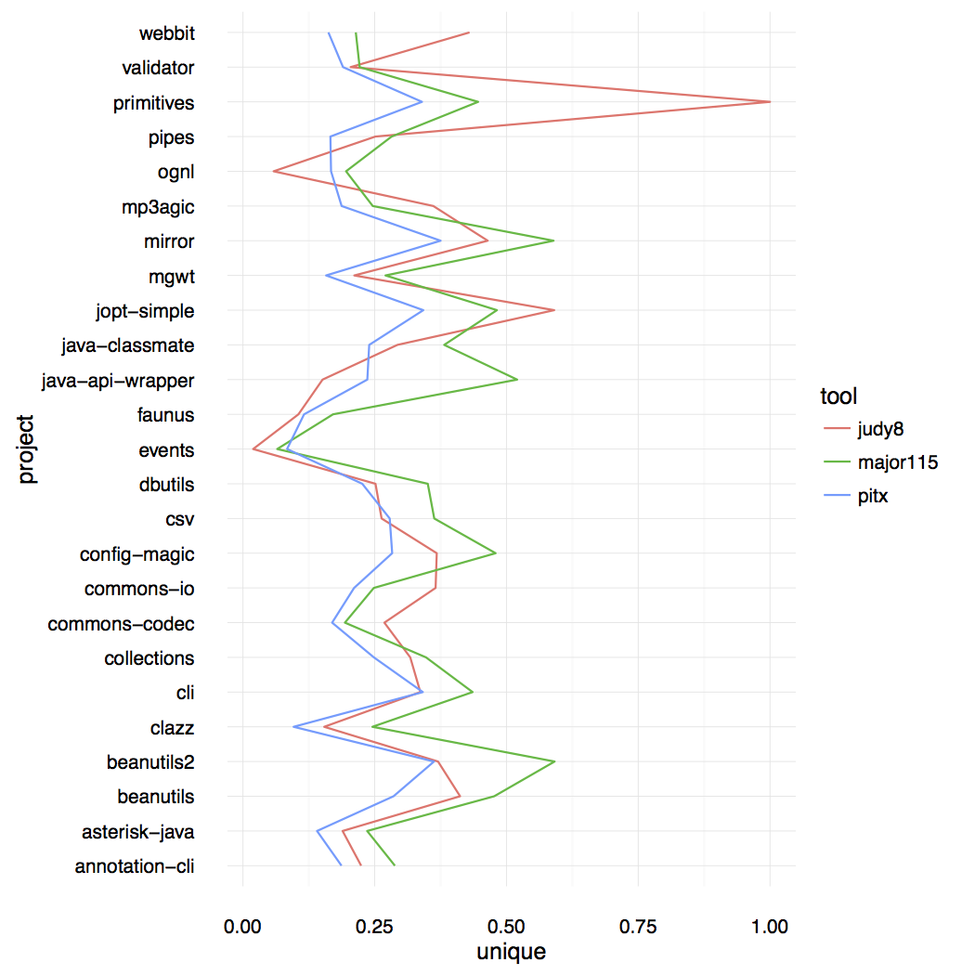
Comparison of tools
The ratio of unique mutants to detected mutants produced by each tool.
Notes:
This graph shows the ratio of unique mutants detected to mutants produced by each tool.
The graph suggests that, no single tool produced the most diverse mutants, and is very much dependent on the particular project.

Slide 50
Conclusion
Mutant sets should be judged on two characteristics
The amount of unique variants
The amount of hard to find faults
We proposed two measures
The diversity of the mutant set : The unique mutant set
The hard to find faults : The surface mutant set – its effectiveness is judged by the volume measure.
Notes:
In conclusion, our point is that mutant sets should be judged on two characteristics
That is, the amount of unique variants
And the amount of hard to find faults
We proposed two measures, one the unique mutant set for measuring diversity of the mutant set, and the other surface set for measuring ease of detection of mutants.
We also performed a benchmark for these measures.

Slide 51
Hierarchy of mutant sets
Mutant selection
All mutants
All mutants
Unique mutants
Unique mutants
Subsumed mutants
Surface mutants
Minimal mutants
Disjoint mutants
Test selection
Minimal
tests
Subsumed
tests
Unique
tests
All
tests
Notes:
We also note that there are different sets depending on how one wishes to remove redundant test cases and mutants.
In the graph here, we have the hierarchy of mutant sets on the Y axis, and the hierarchy of tests on the X axis.
Each axis marks elements according to the size of the set remaining after filtering.
For example one may choose to use all tests for evaluating mutants, or may decide to remove possible duplicate test cases that detect same mutants. We may also remove test cases that are strictly subsumed by other test cases, or by the test suite as a whole.
That is, there are a number of mutant sets that could be obtained by following any of the methods of eliminating redundancies.

Slide 52
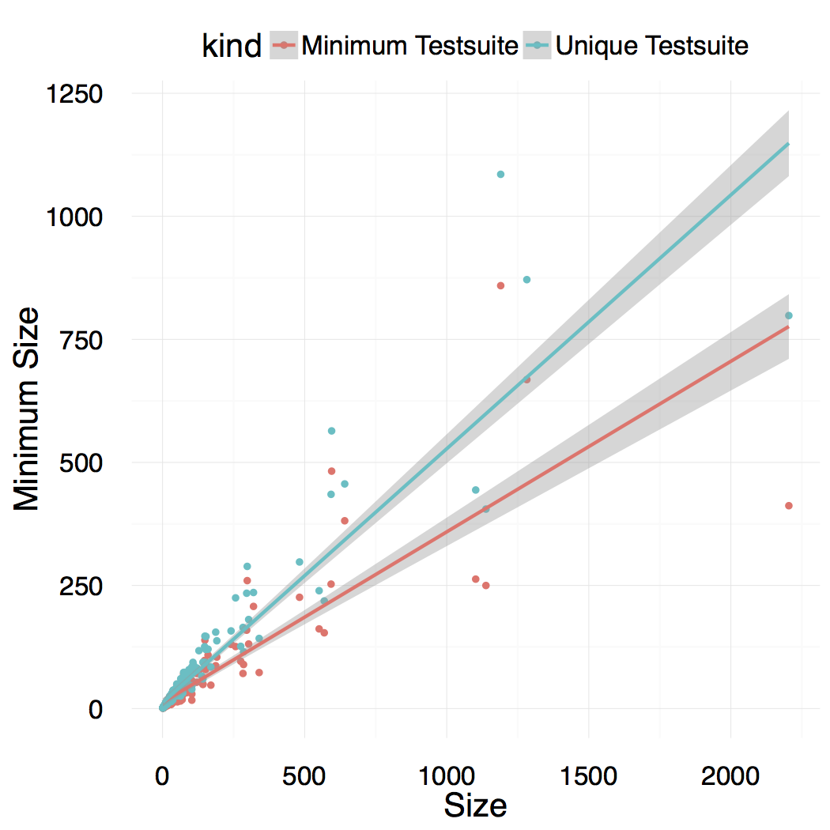
Comparison of tools
The growth of unique mutants compared to disjoint mutants.
Distinct set
Disjoint set
Notes:
This graph shows the growth of the disjoint mutant set and the distinct set as compared to the actual size of mutants.

Slide 53
Benchmarking different tools in a 100 sample
Amount of unique variants produced per mutant
PIT 0.727
Major 0.687
Judy 0.559
Amount of disjoint mutants produced per mutant
PIT 0.458
Major 0.430
Judy 0.301
The average volume ratio
PIT 0.996
Major 0.992
Judy 0.933

Slide 54
Benchmarking different tools
Amount of distinguished variants produced per mutant
PIT 0.224
Major 0.334
Judy 0.307
The average volume ratio
PIT 0.999
Major 0.996
Judy 0.942
Amount of disjoint mutants produced per mutant
PIT 0.0647
Major 0.129
Judy 0.116
Notes:
Our results for the amount of distinguished mutants produced per mutant suggests that Major produced mutants that were slightly more diverse than others, while Pit produced mutants that were slightly more homogenous.
In terms of volume ratio, we find that

Slide 55
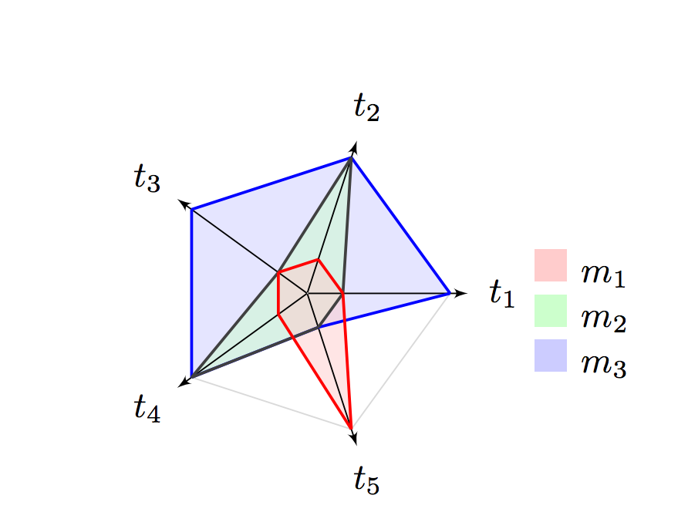
A more complex example : Surface mutants
t1 kills m1,m2
t2 kills m1 t3 kills m1,m2 t4 kills m1
t5 kills m2,m3
m2 subsumed by m3
The surface mutant set is {m1,m3}
The surface mutant set is an alternative to disjoint mutant set
for hard to detect mutants.
Notes:
Here is a more complex example.

Slide 56
A more complex example: Surface mutants.
Rather than the size of
surface mutants, volume ratio is
used to interpret the strength.
The volume ratio is the ratio between possible variants included in the sphere, and the maximal volume of the sphere.
Here, volume ratio = (2^4 + 1)/ 2^5 ~ 0.53

Slide 57
A summary of disjoint mutant set
Disjoint mutant set provides neither the best set of unique faults, nor the complete set of hardest to find faults from the given mutant set.
How to compare size of disjoint mutants is also ambiguous.
(Which ratio should be used to normalize it? )
|disoint mutants| : |all mutants|
Or
|disoint mutants| : |all tests|
Notes:
In summary, disjoint mutant set provides neither the best set of unique faults, nor he complete set of hardest to find faults from the given set of mutants.

Slide 58
Comparing disjoint mutants and surface mutants
Tests | Mutants killed by the given test
t1 | m1 | m1
t2 | m1 |  | m3
t3 |  | m2 | m3
Disjoint mutant set: {m1, m2}
Surface mutant set: {m1, m2, m3}
Surface mutants avoid throwing away useful mutants.
Surface mutants are a larger set than the disjoint mutant set
Notes:
When we compare the actual set of mutants produced, the disjoint mutant set and surface set, we see that surface mutants avoid throwing
away mutants that are not subsumed, and consequently the surface mutants are a larger set.

Slide 59
Judging test suites.
A test suite is measured (usually) on two criteria
Does it prevent a majority of bugs?
We should not discard easy to detect bugs because they are the most critical ones. That is, even if the bug is a strict superset of another, keeping the trivial/non-subtle would help in increasing the priority.
Does it prevent subtle bugs?
Notes:
For a test suite, there are mainly two things that a tester is interested in
The first one is, is it comprehensive enough? That is, does it prevent a majority of bugs?
The second and harder one is, does it prevent subtle bugs?

